Slide 1
CouchDB
…………

Slide 2

What is CouchDB?
CouchDB is clustered database that allows you to run a single logical database server on any number of server or vms.

Slide 3
Overview
Couchdb was introduced in 2005 but later become an apache software foundation project in 2008
Couchdb uses schema free data model
Couchdb is a Document Stoage NonSQL database
Data is in flexible Document based structure so there is no need to worry about structure of data (structured and unstructured)
Couch db facilitate users with powerful data mapping which allows querying combining and filtering the information

Slide 4




Features OF CouchDB
Easy
CouchDB Replication
CouchDB Views
Restful Api

Slide 5
Distributed Architecture with Replication
ACID Semantics
CouchDB provides ACID semantics.[11] It does this by implementing a form of Multi-Version Concurrency Control, meaning that CouchDB can handle a high volume of concurrent readers and writers without conflict.
CouchDB was designed with bi-directional replication (or synchronization) and off-line operation in mind. That means multiple replicas can have their own copies of the same data, modify it, and then sync those changes at a later time.

Slide 6

Document Storage
CouchDB stores data as "documents", as one or more field/value pairs expressed as JSON. Field values can be simple things like strings, numbers, or dates; but ordered lists and associative arrays can also be used. Every document in a CouchDB database has a unique id and there is no required document schema.

Slide 7
MapReduce Views
The stored data is structured using views. In CouchDB, each view is constructed by a JavaScript function that acts as the Map half of a map/reduce operation. The function takes a document and transforms it into a single value that it returns. CouchDB can index views and keep those indexes updated as documents are added, removed, or updated.

Slide 8

HTTP API
All items have a unique URI that gets exposed via HTTP. It uses the HTTP methods POST, GET, PUT and DELETE for the four basic CRUD (Create, Read, Update, Delete) operations on all resources.

Slide 9
Advantages
Document model: it is easy to serialize objects to JSON store them retrieve and deserialize when we needed them back
No readlocks: if you ever need to update or modify a table the row of data being changed becomes locked to other users until the modification request is processed
CouchDB is open source, project, supported and developed by a community of contributors.
Scalable : the architectural design of couchdb makes it extremely adaptable when partitioning dbs and scaling data into multiple nodes

Slide 10
Disadvantages
Performance Issues
High Disk and Memory Usage:
MapReduce Complexity:
CouchDB can be slow for writing and querying large datasets because of its append-only storage and the need for proper indexing and complex view design.
The append-only storage model leads to high disk space usage due to document revisions, necessitating periodic compaction. Large databases and views also consume significant memory
Designing and implementing MapReduce views requires a good understanding of JavaScript and the MapReduce paradigm, presenting a significant learning curve.

Slide 11
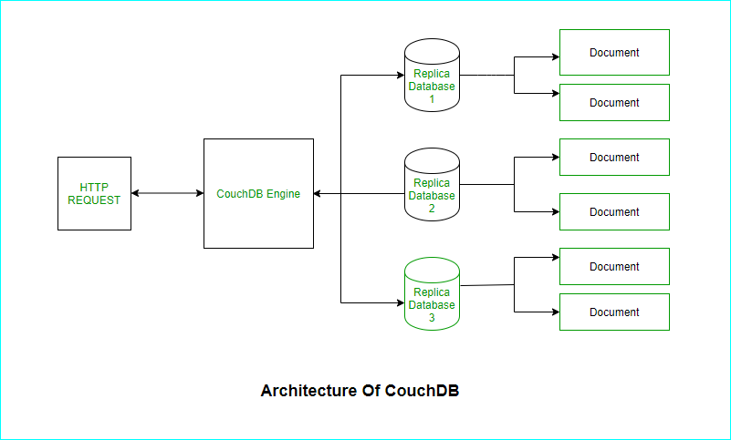
How CouchDB Works?

Slide 12
Example
BBC iPlayer is a streaming service provided by the British Broadcasting Corporation (BBC). It offers a variety of TV shows, movies, and radio programs to users, and it needs to manage a large amo
Why CouchDB?
Schema Flexibility:
Replication:
Offline Capabilities:

Slide 13
Implementation Details
Metadata Storage: Each piece of content (e.g., a TV show or movie) is stored as a document in CouchDB. These documents contain various fields like title, description, genre, cast, release date, etc.
User Preferences: User-specific data, such as watch history, favorite shows, and personalized recommendations, are stored in CouchDB. Each user's preferences are stored in a separate document, allowing for easy updates and retrieval.
Replication Setup: CouchDB is set up to replicate data across multiple data centers, ensuring that users get fast access to content metadata and their preferences, no matter where they are located.
Conflict Resolution: During replication, any conflicts in user data (e.g., different watch histories from different devices) are resolved using CouchDB’s built-in mechanisms to ensure data consistency.

Slide 14
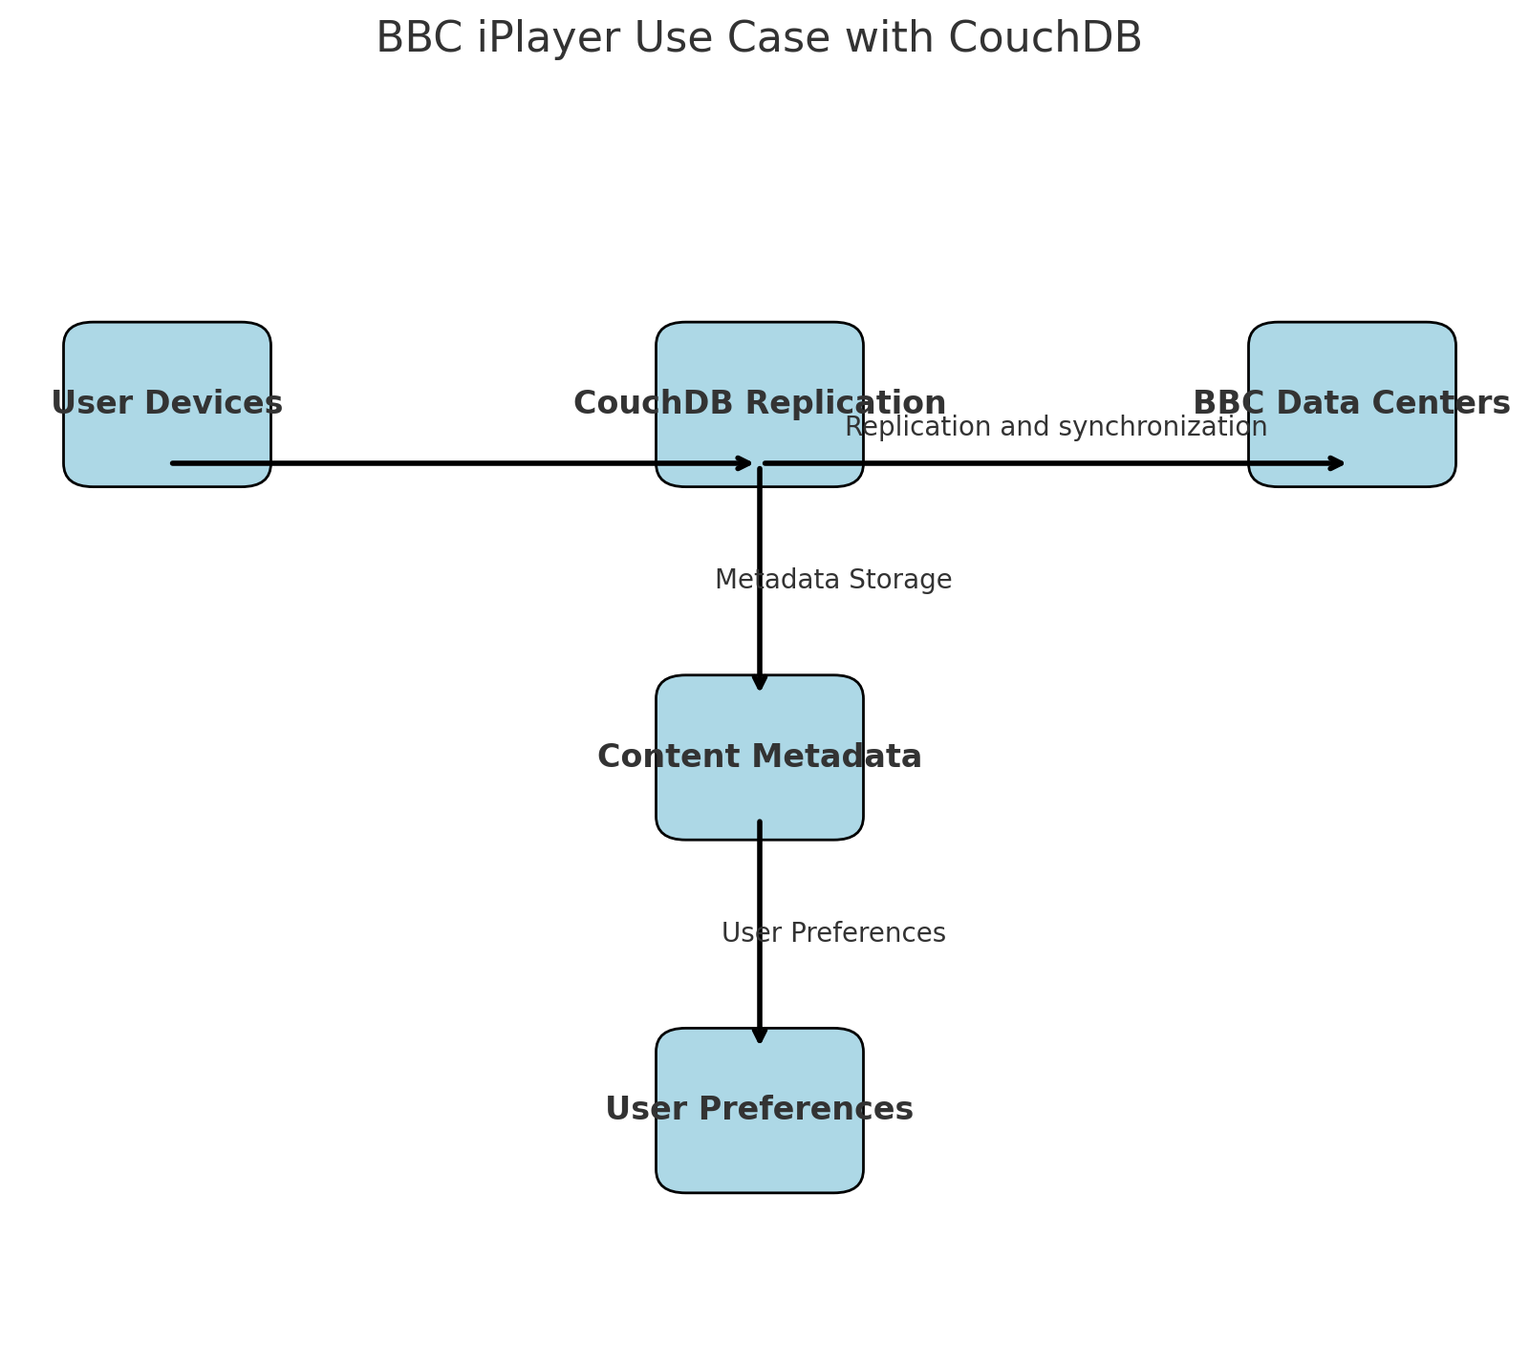
Use Case

Slide 15
DEMO VIDEO

Slide 16
